Slide 1
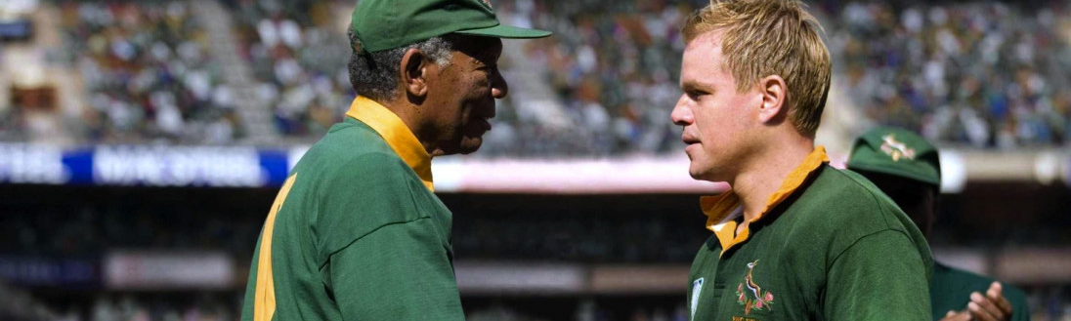

Invictus
Film Appreciation
WPSG Activity
Done By : Krishnaraj PT, 109054

Slide 2
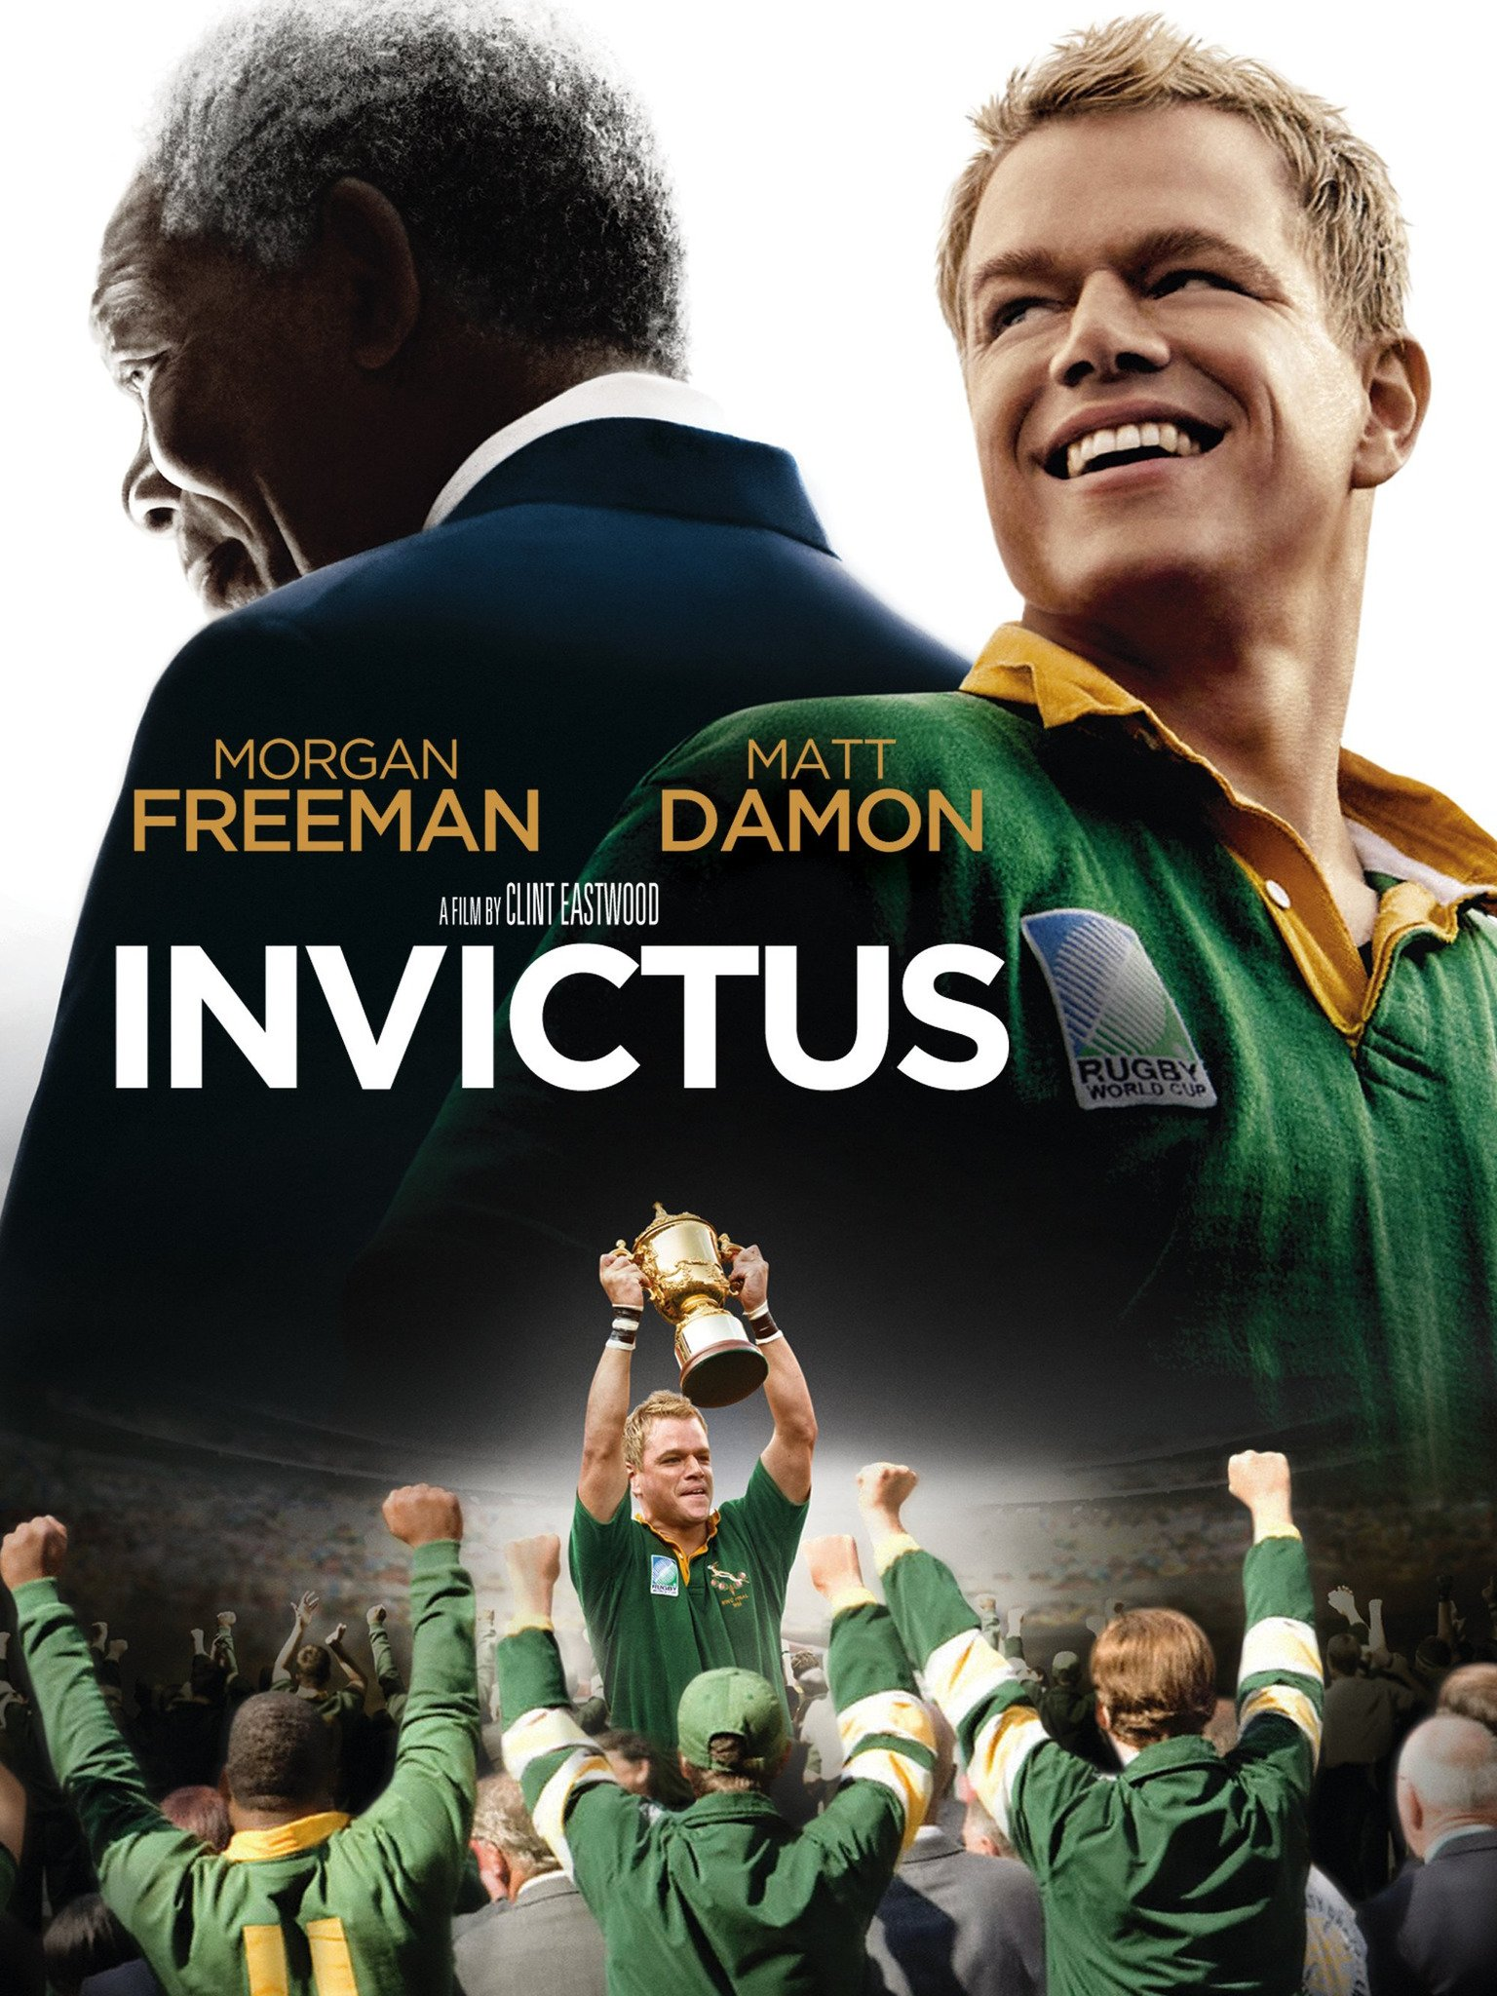
The Story Outline
Invictus is a 2009 biographical sports drama film directed by Clint Eastwood and starring Morgan Freeman and Matt Damon. The story is based on the 2008 John Carlin book Playing the Enemy: Nelson Mandela and the Game That Made a Nation about the events in South Africa before and during the 1995 Rugby World Cup.
The story portrays the struggles faced by South Africa post Apartheid, and how their new President – Nelson Mandela adapted to these new changes and helped in uniting the Nation once and for all.

Slide 3
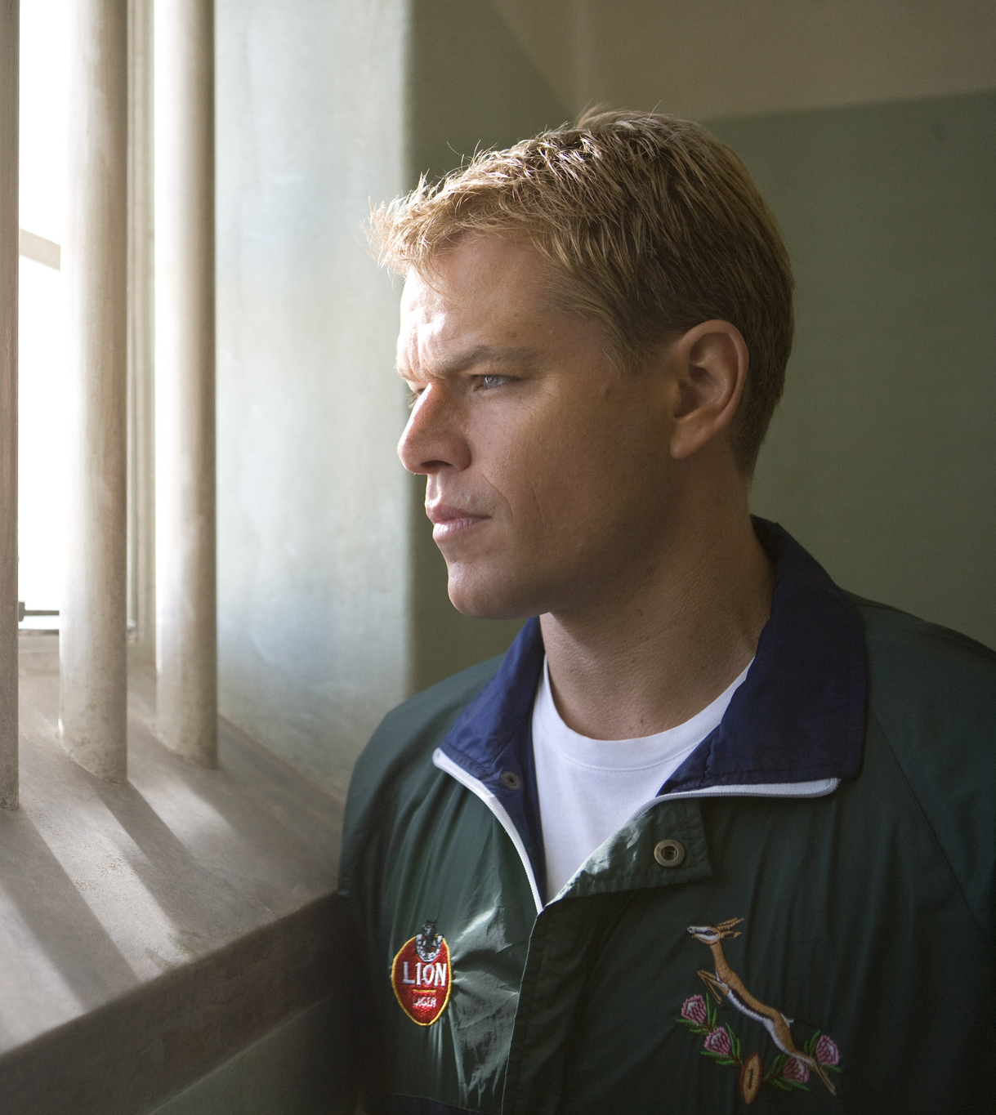
Rugby was a nationally loved sport and in a way, the heart of South Africa. Mandela saw Rugby as an opportunity to revive the spirit of the New and United South Africa.
The Film very accurately and thoroughly portrays how he does this with the help of the South African Captain - François Pienaar.
It also shows how the people of South Africa reacted to the new changes.
The differences between them diminished eventually, but the tension after and before the election saw a lot of discrimination, racism and panic. That is also accurately and sensitively represented in the film.

Slide 4
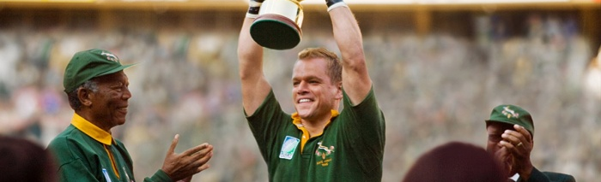
Central Theme
Newly elected President Mandela knows his nation remains racially and economically divided in the wake of apartheid. Believing he can bring his people together through the universal language of sport, Mandela rallies South Africa's underdog rugby team as they make an unlikely run to the 1995 World Cup Championship match.
Leadership forms a major theme of the film. In meeting with Francois, Mandela asks him how a leader can inspire those he leads to greatness, to be better than they think they can be. Leaders appeal to “the better angels of our nature,” encouraging the best in us and more both by their actions and example.

Slide 5
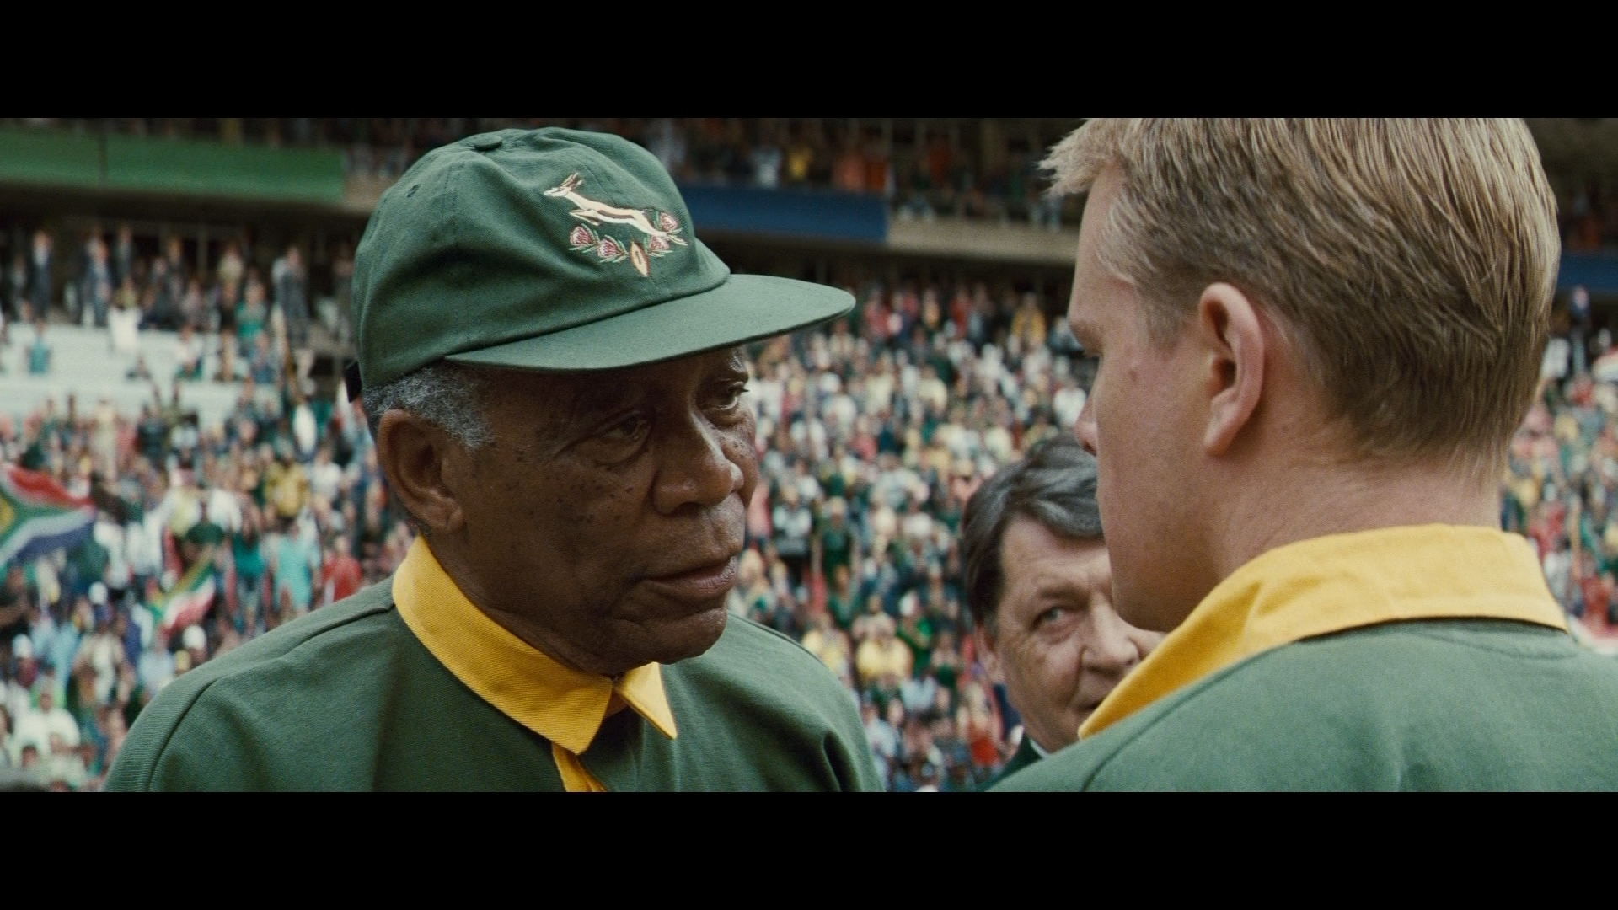
Key moments
Throughout the film, there were several Key moments that were major turning points and had they been done any differently, they would have changed the course of history as we know it now. Some of those scenes are shown in the following slides.

Slide 6
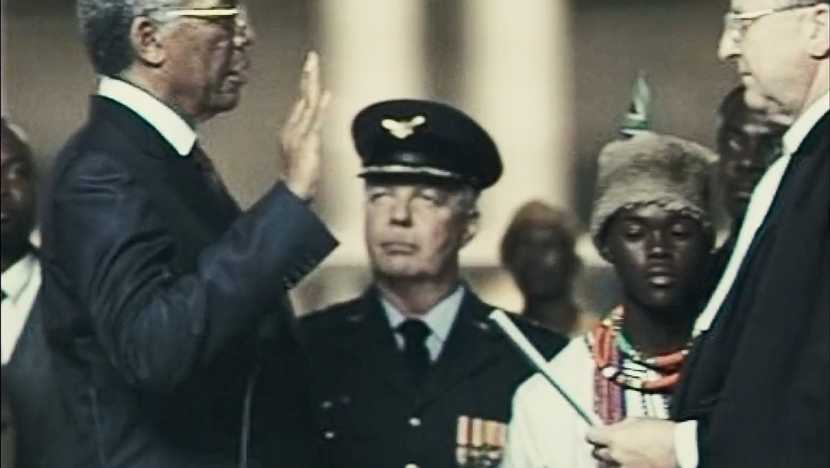
Nelson Mandela Takes Oath as the President of South Africa

Slide 7
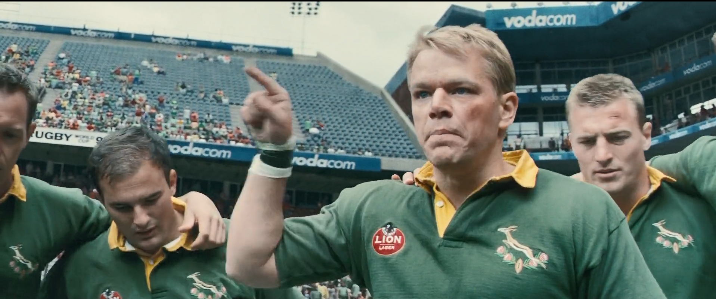
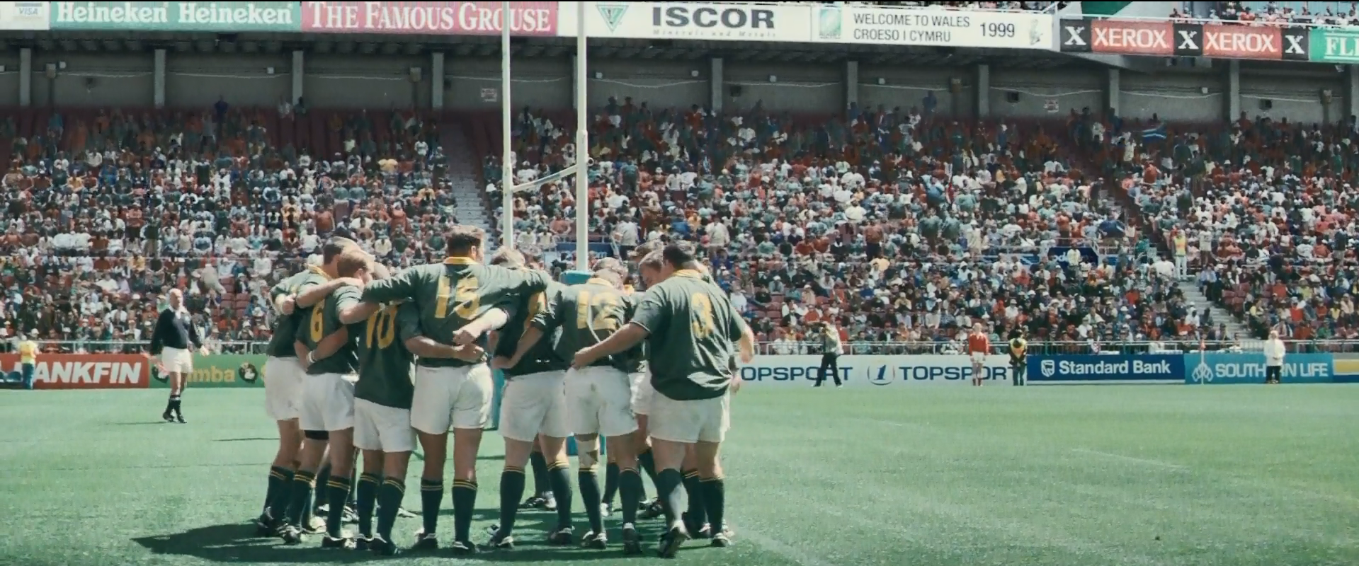
Captain Francois’ Speech Inspires the Team before the Final

Slide 8
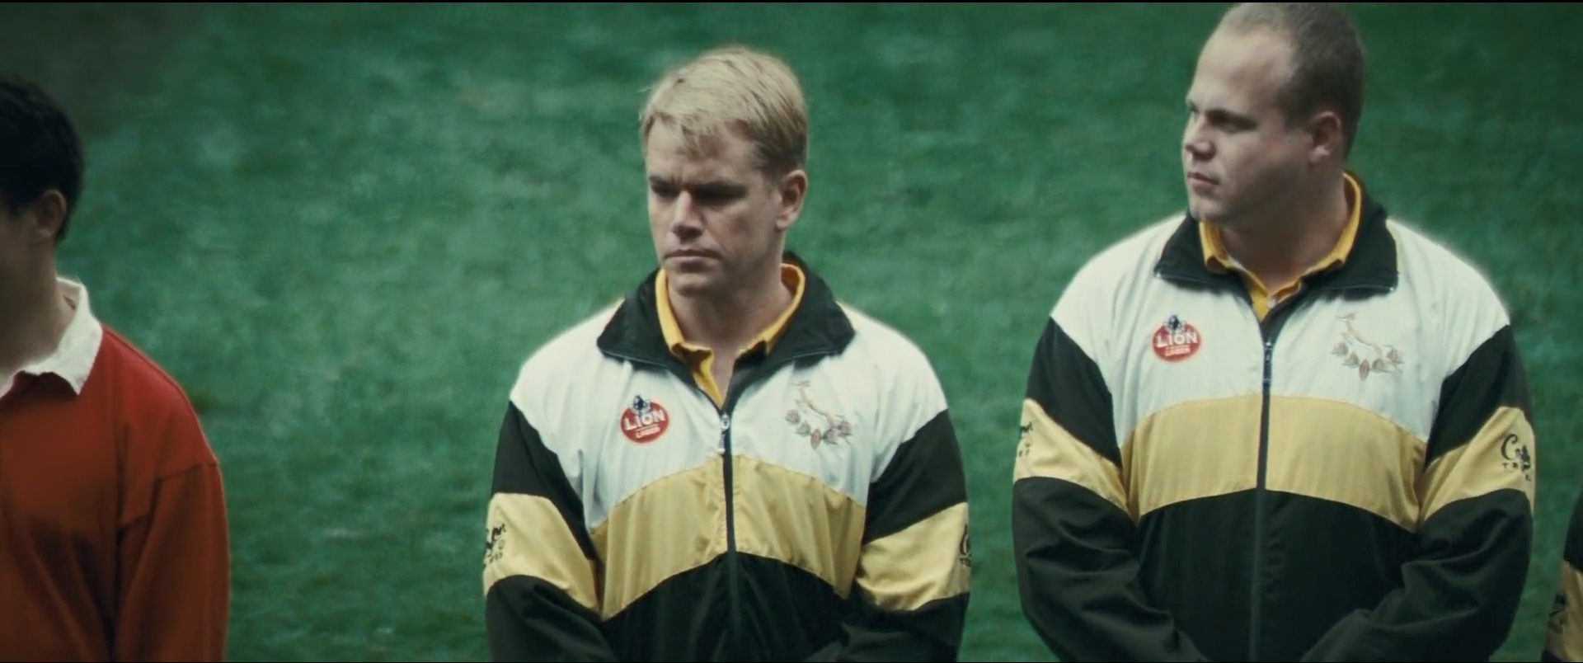

Slide 9
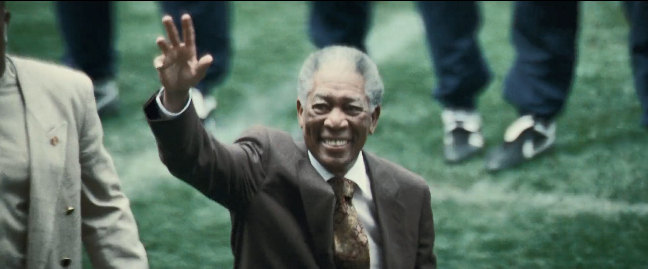

Slide 10
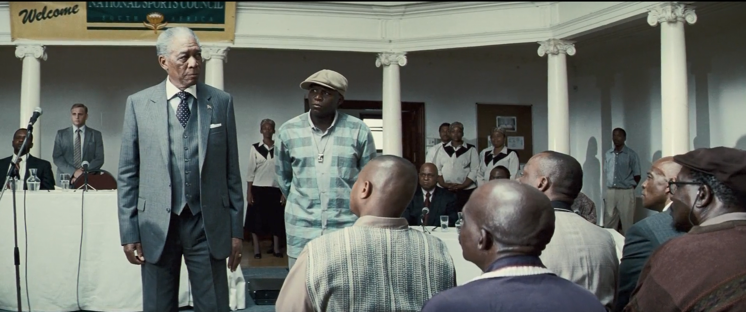

Slide 11
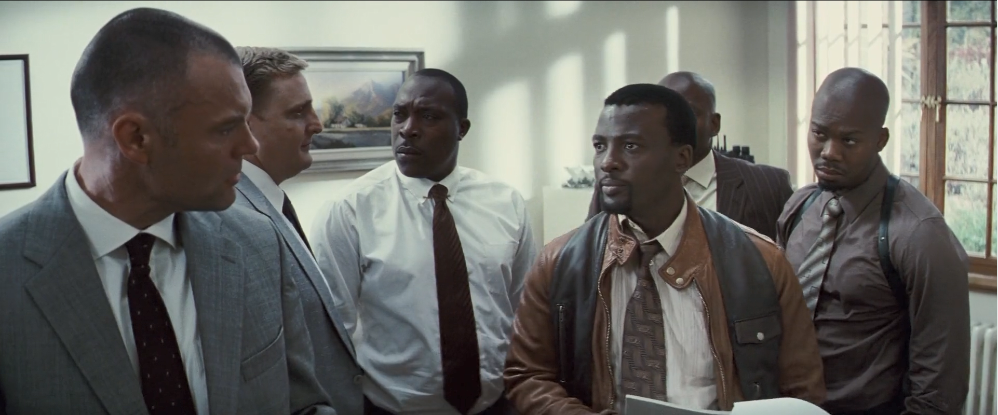

Slide 12
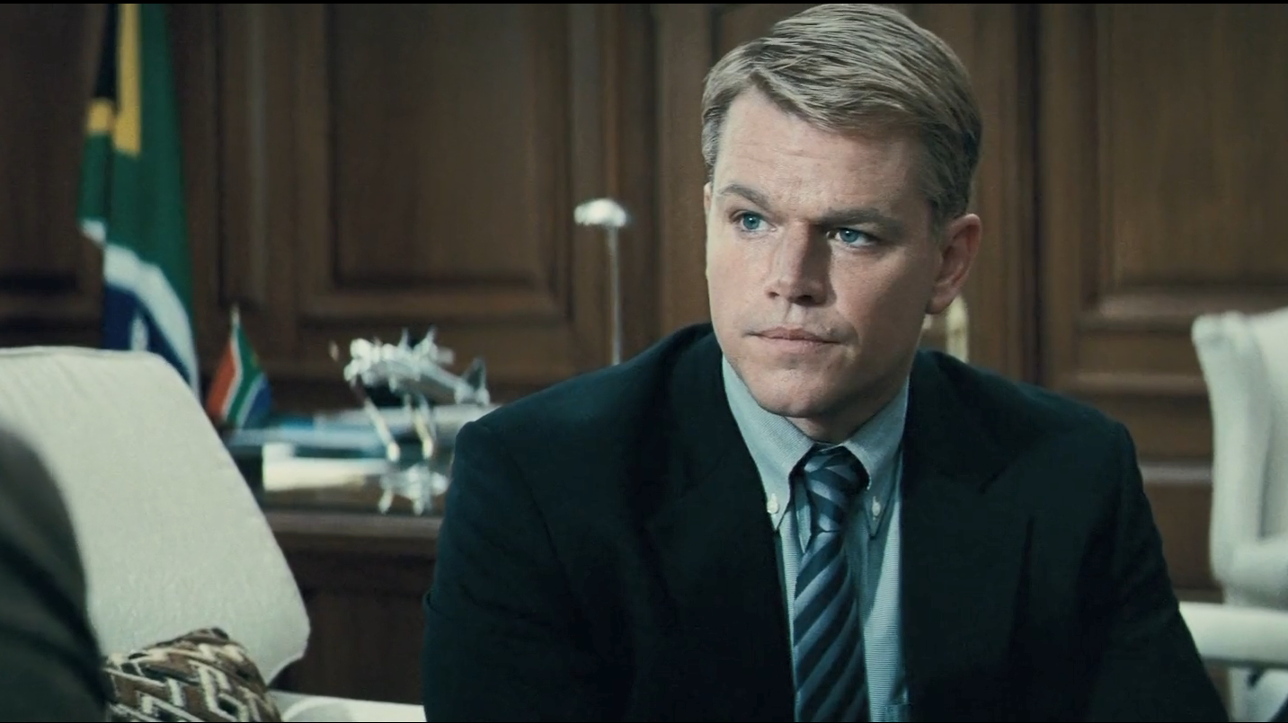
President Mandela Meets Captain Francois

Slide 13
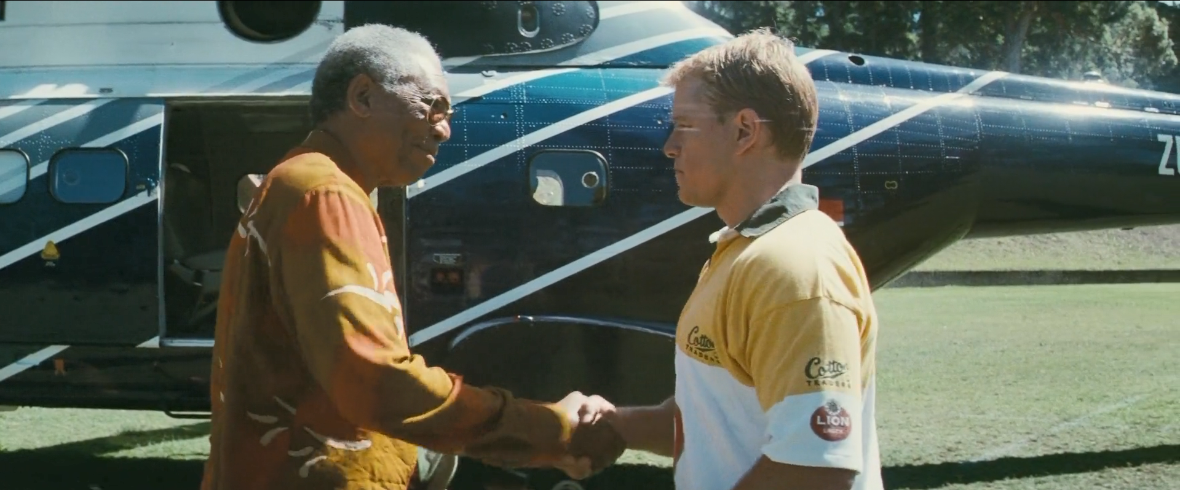

Slide 14
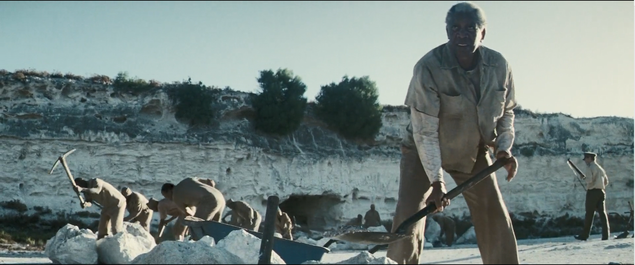

Slide 15
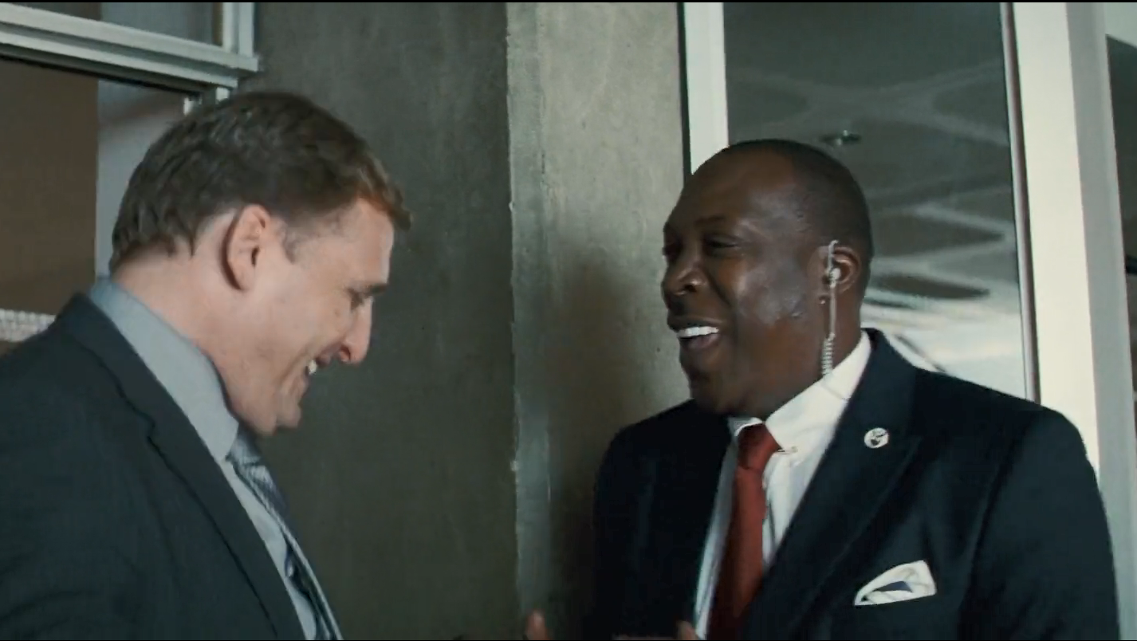
The President’s Security guards celebrate together

Slide 16
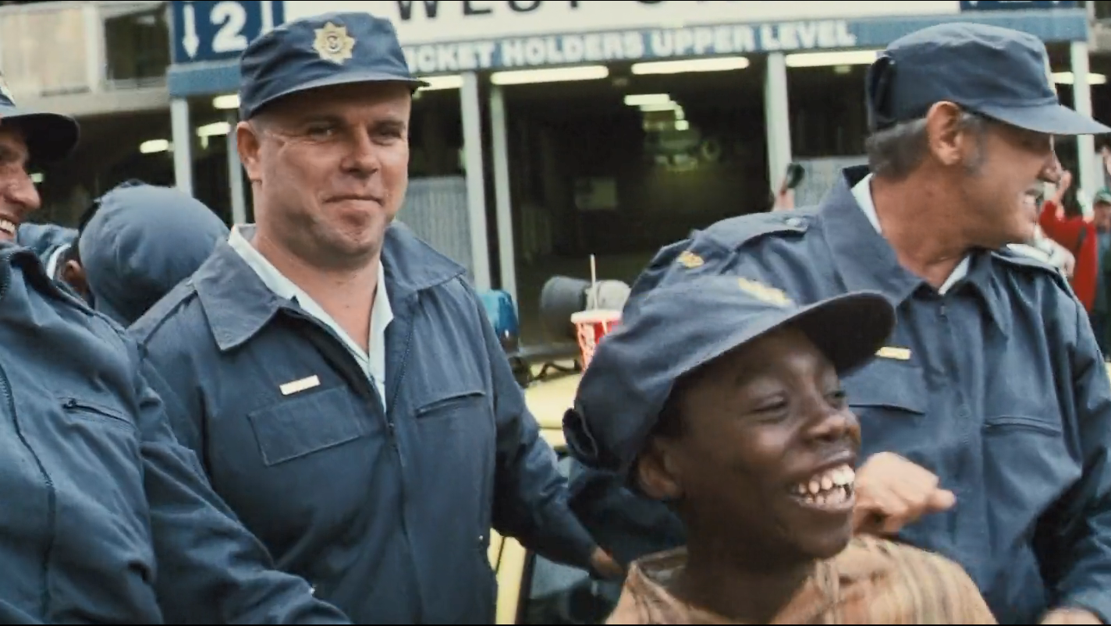
The White Policemen celebrate with a local Kid

Slide 17
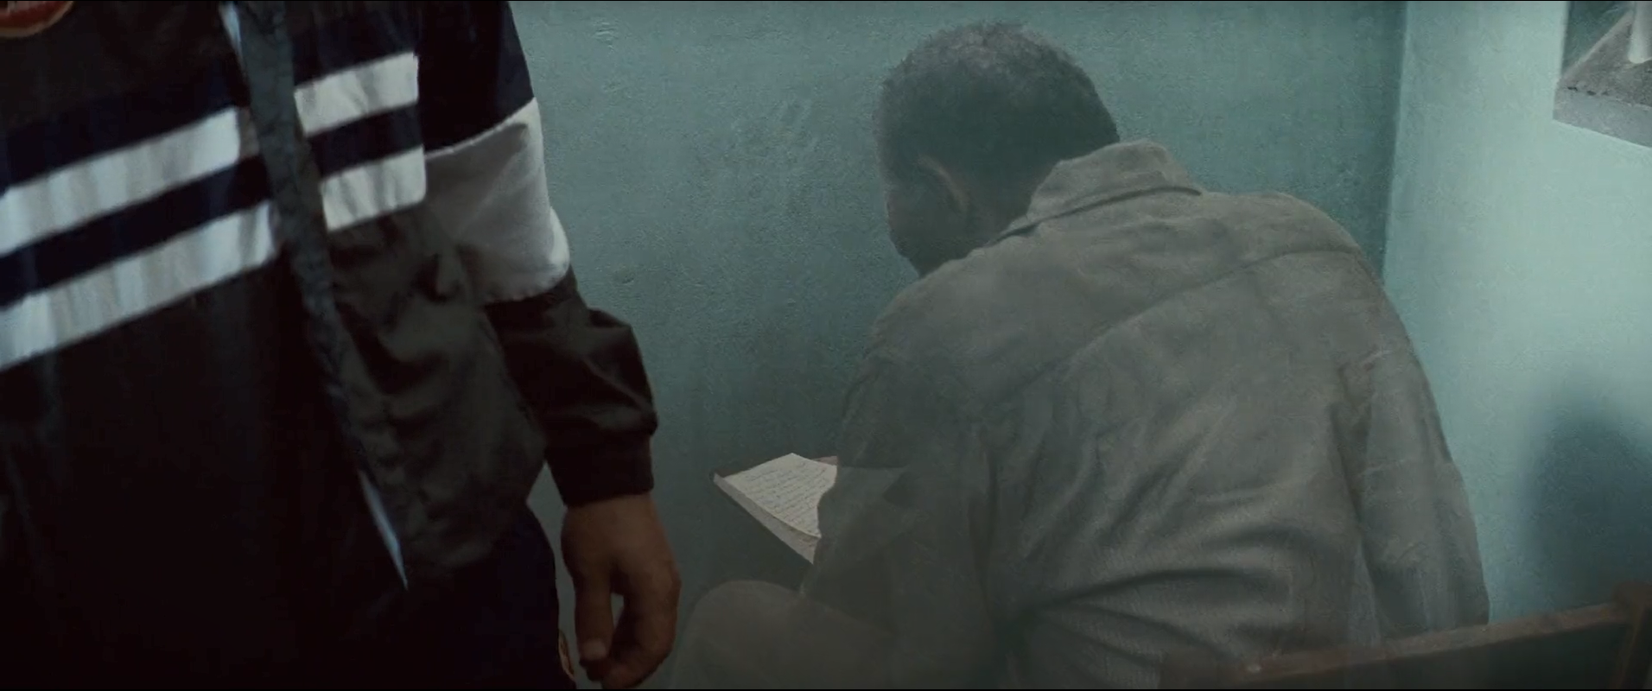

Slide 18
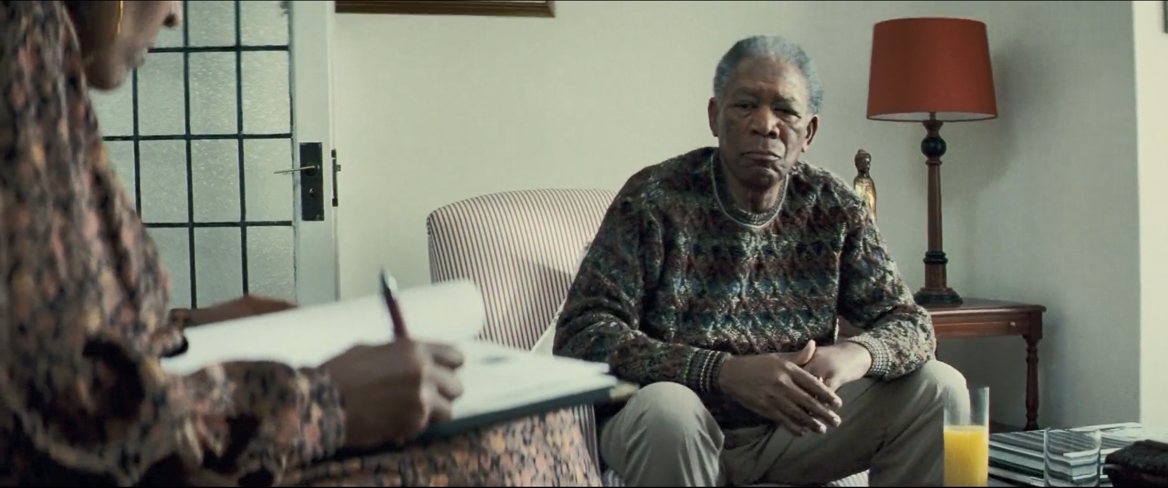

Slide 19
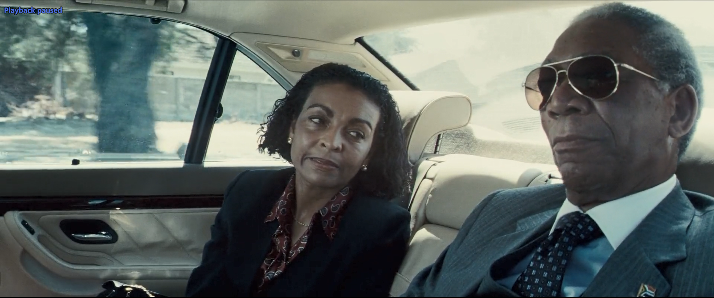

Slide 20
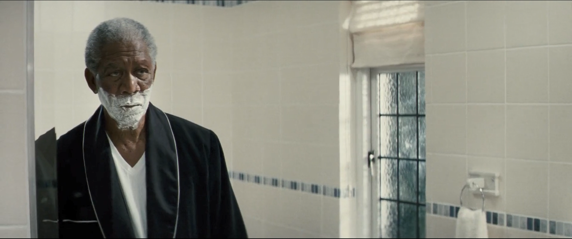

Slide 21
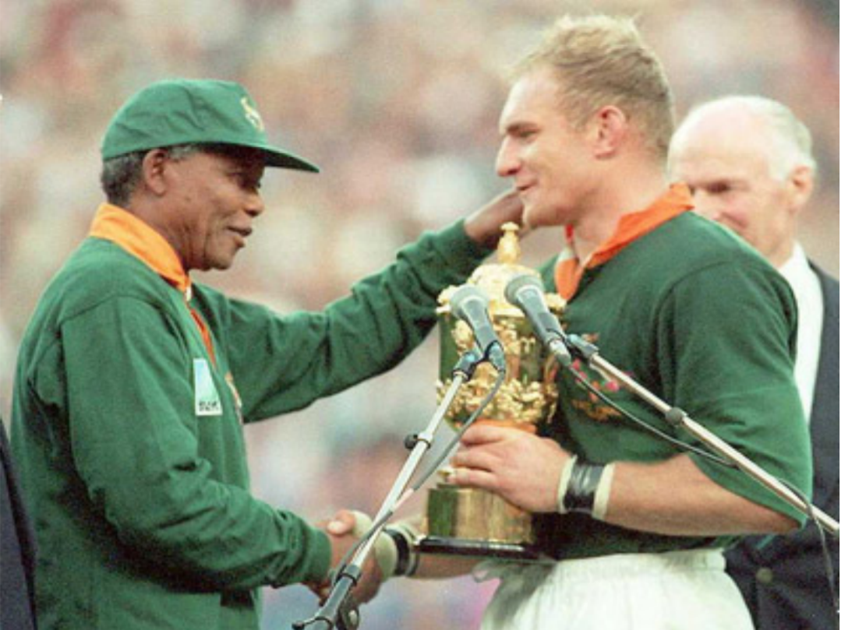
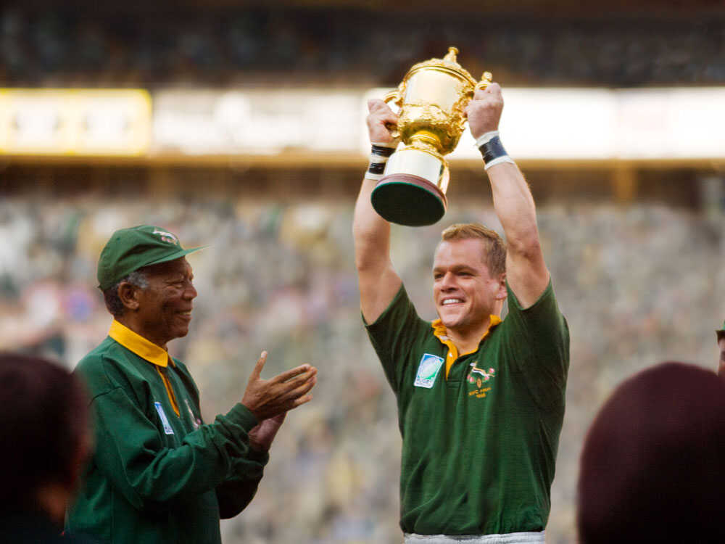
“Sport has the power to change the world. It has the power to inspire, it has the power to unite people, and in a way that little else does.” – Nelson Mandela

Slide 22
Critical Views
The film was very well reviewed and well critiqued. It had aimed to portray the struggles of Mandela in uniting a broken and deeply wounded South Africa post Apartheid – and it accomplishes that in excellent manner. A movie about Racial Injustice, Discrimination, and Suffering is just as much about Leadership, Inspiration and of the many other things – Rugby.
It performed very well, and the credit must definitely go to the storyline, and acting, and Morgan Freeman’s Mandela single-handedly grabs your attention throughout, while being equally complemented by Matt Damon’s Francois Pienaar.
It is so well played in fact, that when a shot of the real Mandela appears over the final credits, it's momentarily jarring to realize you've been watching an impersonation.

Slide 23
What We can Learn
The Movie Makes us realize countless things that often go unnoticed. It teaches us everything from leadership and perseverance to Rugby and Teamspirit, and does it incredibly well. Some of the things that were taught in the movie, through the character and image of Mandela himself are shown in the following slides.

Slide 24
1. Passion Produces Perseverance
Not only was the Madiba willing to unite South Africa, he was passionate about his dream of a country, one that was united and treated everyone equally. It didn’t matter if he had to wait 27 years for it. It didn’t matter if only the entire world ridiculed him for it. All that mattered was the passion that gave him the energy to persevere through everything that came his way.

Slide 25
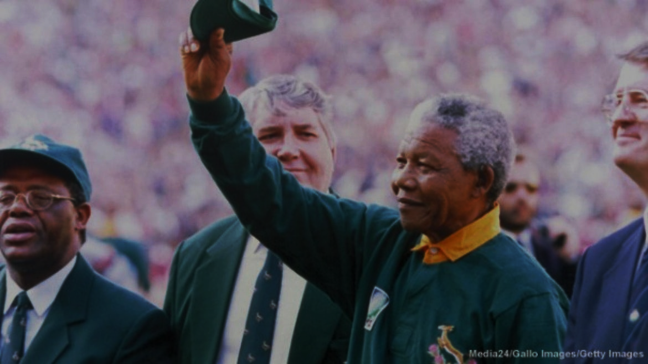
2. Violence is not the answer
No matter how bad the situations got in front of him, he never even thought of considering violence to combat it. This is primarily because he had faced and had been a victim of it himself. He knew that there was no end to it, and that if we decided to follow this path, it would only get dirtier and bloodier along the way.

Slide 26
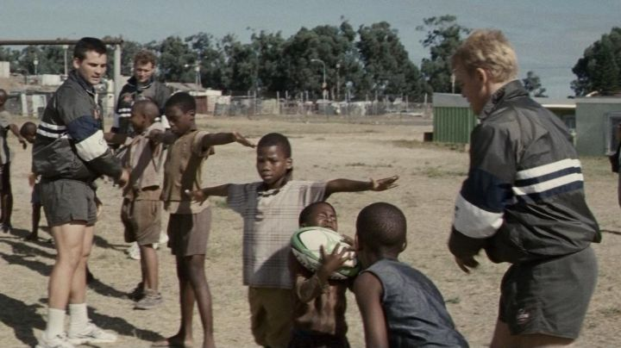
3. Learn how to forgive
What the Madiba achieved in his tenure is quite shocking, not just because of what he did, but because of how he did it. The self control and forgiveness that he showed to his people was phenomenal and infectious. He led a group of people that he was a part of and convinced them and himself that they were now a part of something bigger that included their enemies. Even saying it out loud will cause confusion in your head. Voluntarily putting back all the grudges of your past and forgiving everyone who has ever done anything wrong to you and your people is perhaps not even imaginable, and yet was achieved spectacularly.

Slide 27
4. Bond by sharing experience
A political leader in his position could have either given speeches and parades, a couple of paragraphs in the local Newspaper, and maybe a few TV interviews in hopes of diffusing the situation, But Mandela firmly believed that if you want to bond the country, words were clearly not enough. You needed something to bond over, which in this case was the National Sport Rugby. That Final Match is still believed to have been the one that united a nation.

Slide 28
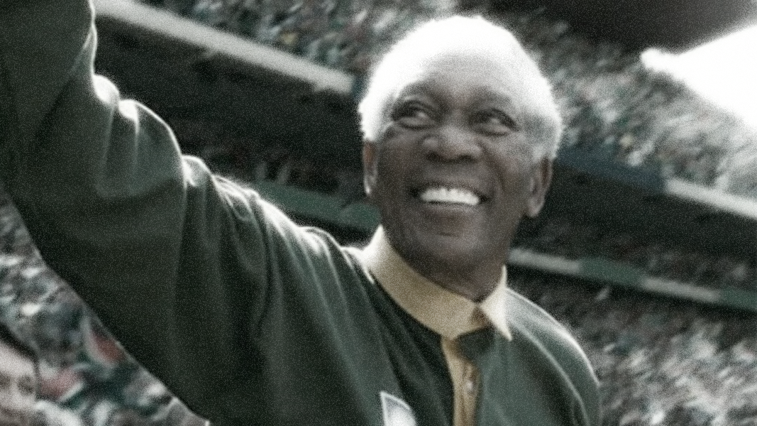
Thank You!

